Slide 1
Lecture 10-12
Introduction to relational Model

Slide 2
Outline
The Relational Algebra
Select Operation
Project Operation
Union Operation
Set Difference Operation
Set intersection Operation
Cartesian Product Operation
Rename Operation
Join Operations

Slide 3
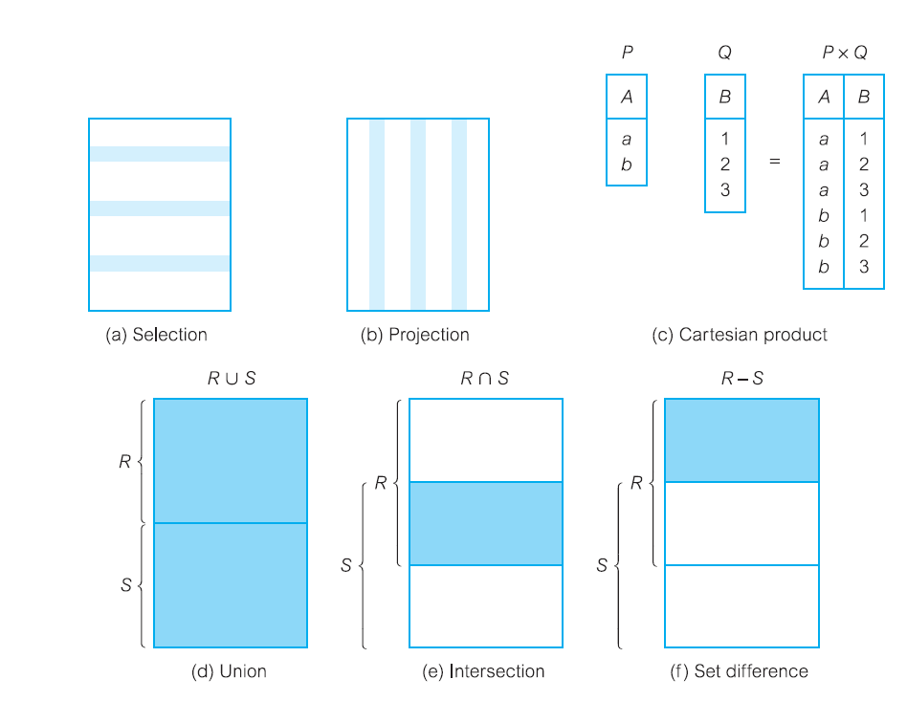
Function of the relational algebra operations.

Slide 4
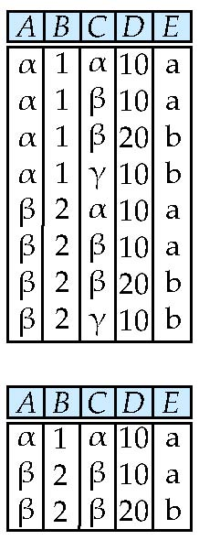
Composition of Operations
Can build expressions using multiple operations
Example: σ_{A=C} (r x s)
r x s
_{A=C} (r x s)

Slide 5
Join Operations
Join is a derivative of Cartesian product.
Equivalent to using join predicate as selection formula, over Cartesian product of the two operand relations.
There are various forms of the Join operation, each with subtle differences, some more useful than others:
• Theta join
• Equijoin (a particular type of Theta join)
• Natural join
• Outer join
• Semijoin

Slide 6
Theta join (θ-join)
R _{F}S
Defines a relation that contains tuples satisfying the predicate F from the Cartesian product of R and S.
The predicate F is of the form R.a_{i} θ S.b_{i} where θ may be one of the comparison operators (<, ≤, >, ≥, =, ≠).
Can rewrite Theta join using basic Selection and Cartesian product operations.
R _{F}S = σ_{F}(R Χ S)
Degree of a Theta join is sum of degrees of the operand relations R and S. If predicate F contains only equality (=), the term Equijoin is used.

Slide 7
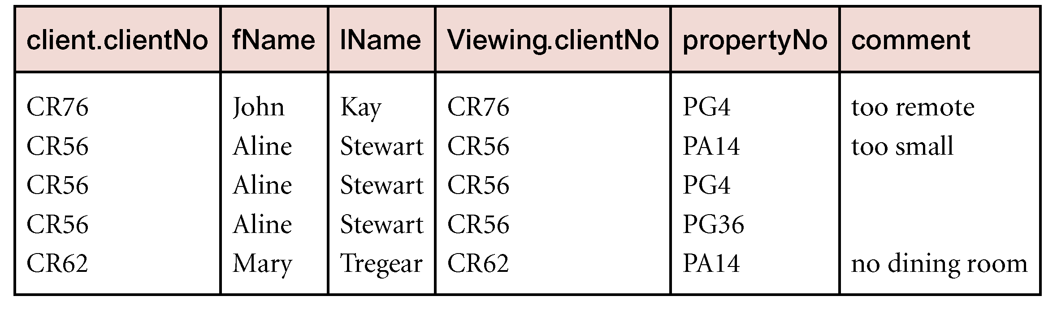
Example - Equijoin
List the names and comments of all clients who have viewed a property for rent.
(Π_{clientNo, fName, lName}(Client)) Client.clientNo = Viewing.clientNo (Π_{clientNo, propertyNo, comment}(Viewing))

Slide 8
Natural join (R S)
An Equijoin of the two relations R and S over all common attributes x. One occurrence of each common attribute is eliminated from the result.

Slide 9
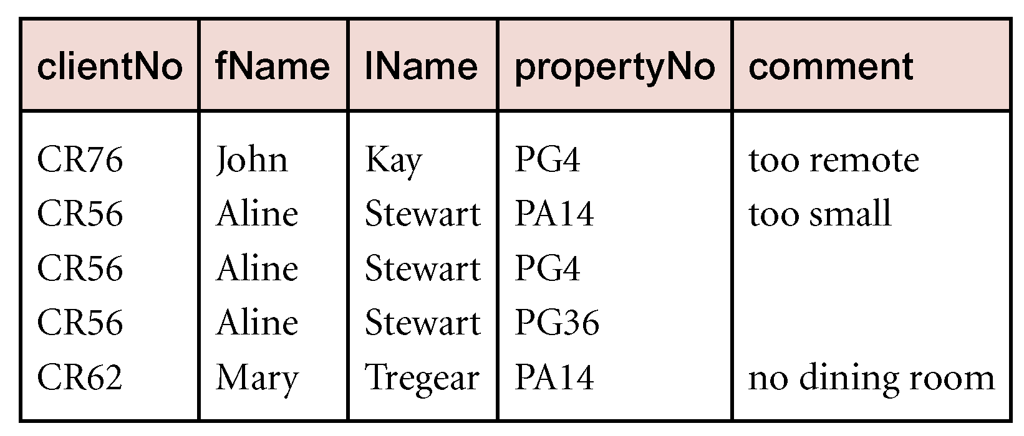
Example
List the names and comments of all clients who have viewed a property for rent.
(Π_{clientNo, fName, lName}(Client)) (Π_{clientNo, propertyNo, comment}(Viewing))

Slide 10
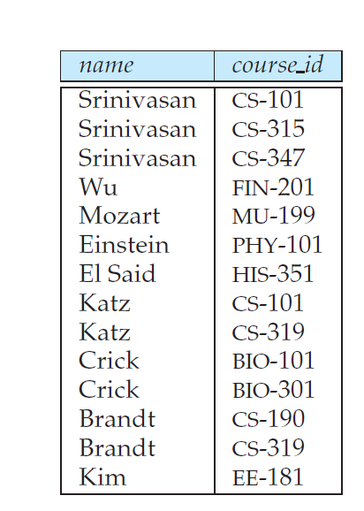

Example
Find the names of all instructors together with the course id of all courses they taught.

Slide 11
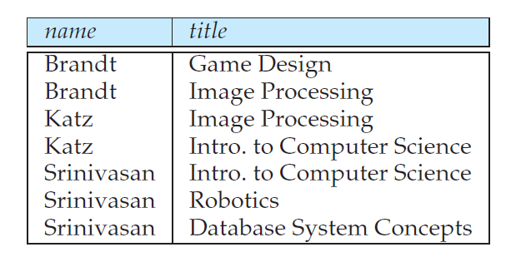
Example
Find the names of all instructors in the Comp. Sci. department together with the course titles of all the courses that the instructors teach

Slide 12
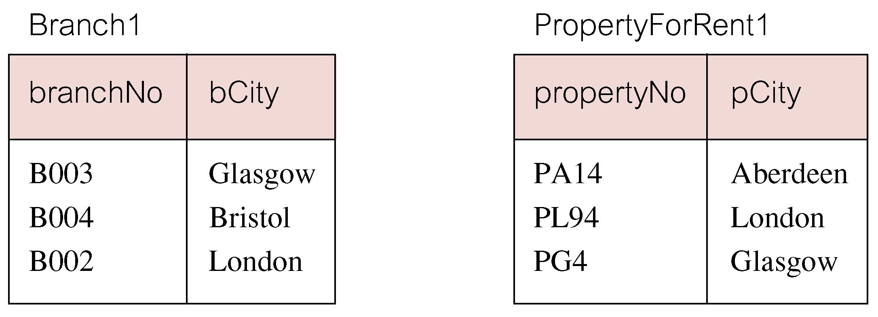
Outer Joins
In an outer join, along with tuples that satisfy the matching criteria, we also include some or all tuples that do not match the criteria.
Result table has two rows where cities are same.
There are no rows corresponding to branches in Bristol and Aberdeen.
To include unmatched rows in result table, use an Outer join.

Slide 13
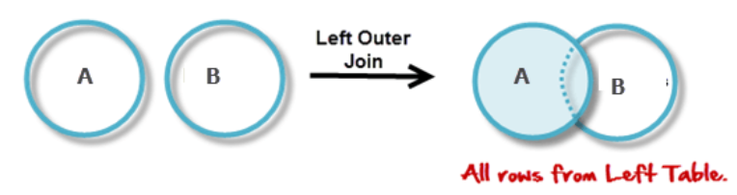
Left Outer Join (R S)
(Left) outer join is join in which tuples from R that do not have matching values in common columns of S are also included in result relation.
Unmatched columns are filled with NULLs.

Slide 14

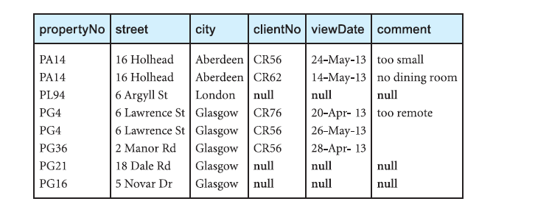
Example: Left(Natural) Outer Join
Produce a status report on property viewings.

Slide 15
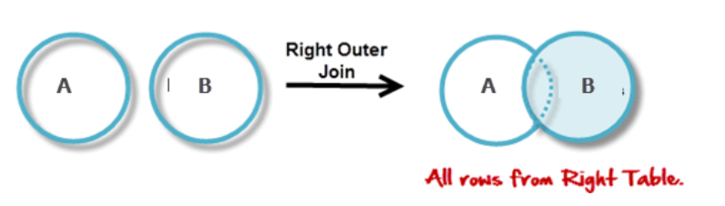
Right Outer Join (R S)
Right Outer join includes those rows of second (right) table that are unmatched with rows from first (left) table.

Slide 16

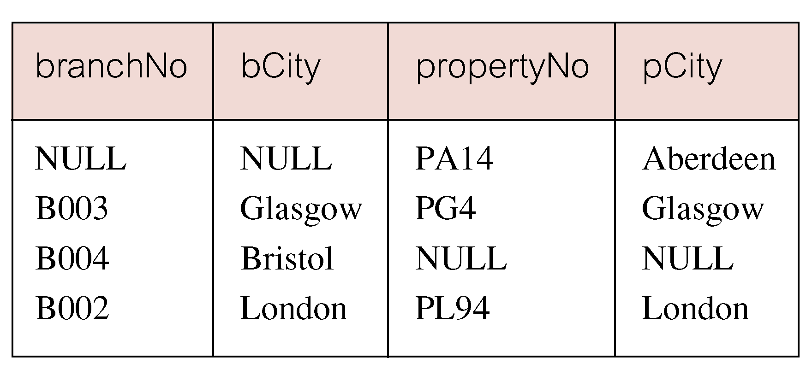
Full Outer Join
Includes rows that are unmatched in both tables.
Unmatched columns are filled with NULLs.

Slide 17
Semijoin
R _{F} S
Defines a relation that contains the tuples of R that participate in the join of R with S.
Can rewrite Semijoin using Projection and Join:
R _{F} S = Π_{A}(R _{F} S)
A is the set of all attributes for R

Slide 18
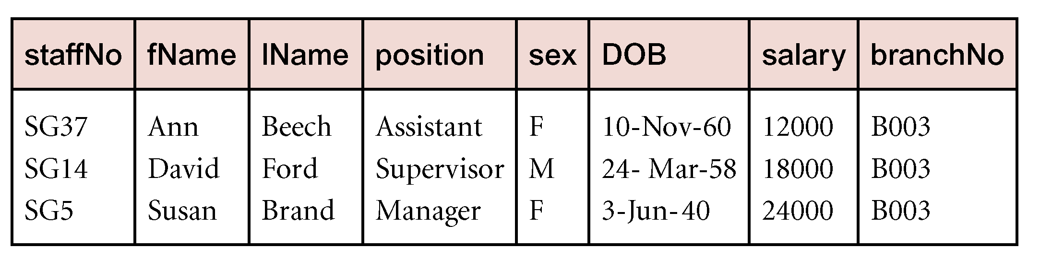
Example
List complete details of all staff who work at the branch in Glasgow.
Staff _{Staff.branchNo=Branch.branchNo}(σ_{city=‘Glasgow’}(Branch))

Slide 19
Division
R ÷ S
Defines a relation over the attributes C that consists of set of tuples from R that match combination of every tuple in S.
Expressed using basic operations:
T₁ ← Π_{C}(R)
T₂ ← Π_{C}((S X T₁) – R)
T ← T₁ – T₂

Slide 20
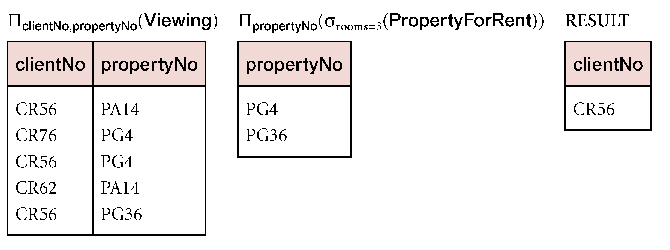
Example - Division
Identify all clients who have viewed all properties with three rooms.
(Π_{clientNo, propertyNo}(Viewing)) ÷ (Π_{propertyNo}(σ_{rooms = 3} (PropertyForRent)))

Slide 21
Aggregate Operations
ℑ_{AL}(R)
Applies aggregate function list, AL, to R to define a relation over the aggregate list.
AL contains one or more (<aggregate_function>, <attribute>) pairs .
Main aggregate functions are: COUNT, SUM, AVG, MIN, and MAX.

Slide 22
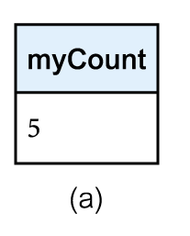
Example
How many properties cost more than £350 per month to rent?
ρ_{R}(myCount) ℑ_{COUNT} _{propertyNo} (σ_{rent > 350} (PropertyForRent))

Slide 23
Grouping Operation
_{GA}ℑ_{AL}(R)
Groups tuples of R by grouping attributes, GA, and then applies aggregate function list, AL, to define a new relation.
AL contains one or more (<aggregate_function>, <attribute>) pairs.
Resulting relation contains the grouping attributes, GA, along with results of each of the aggregate functions.

Slide 24
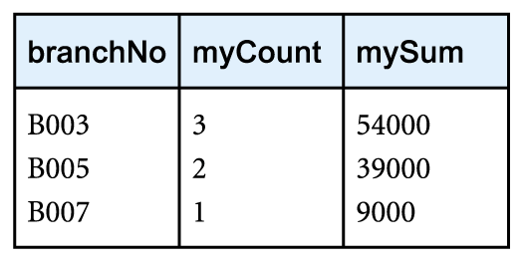
Example
Find the number of staff working in each branch and the sum of their salaries.
ρ_{R}(branchNo, myCount, mySum) _{branchNo} ℑ _{COUNT staffNo,} _{SUM salary} (Staff)

Slide 25
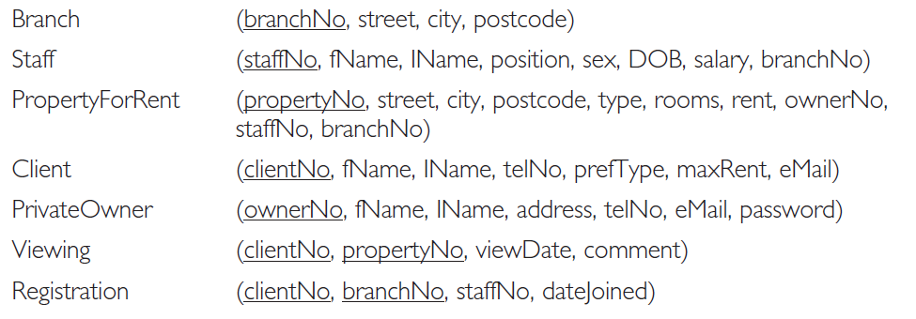
Relational schema for part of the DreamHome case study

Slide 26
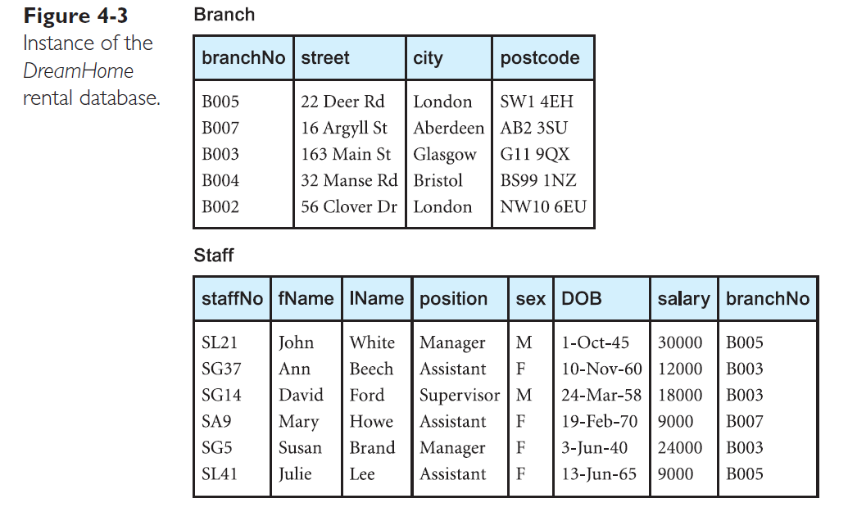

Slide 27
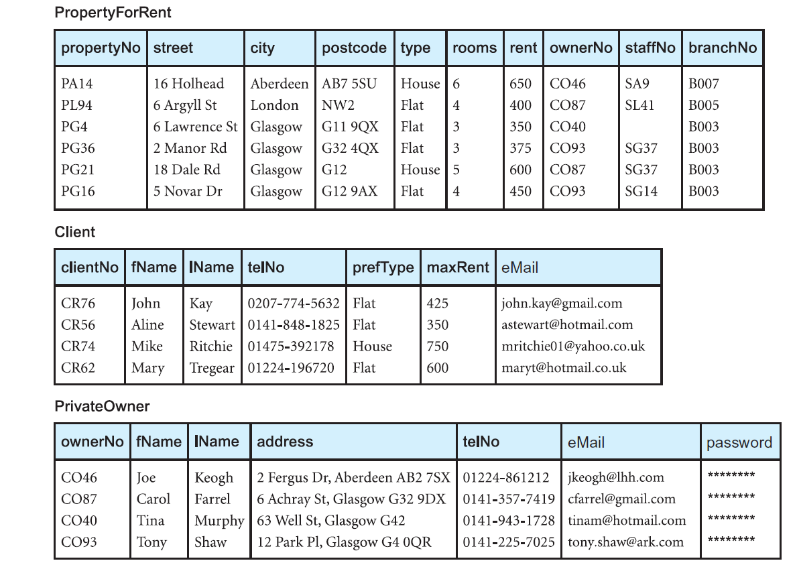
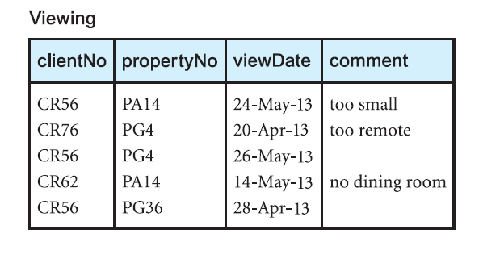
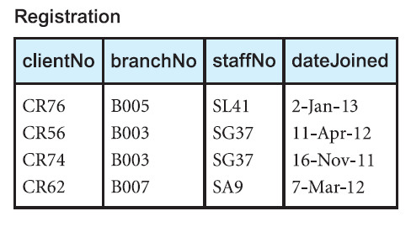

Slide 28
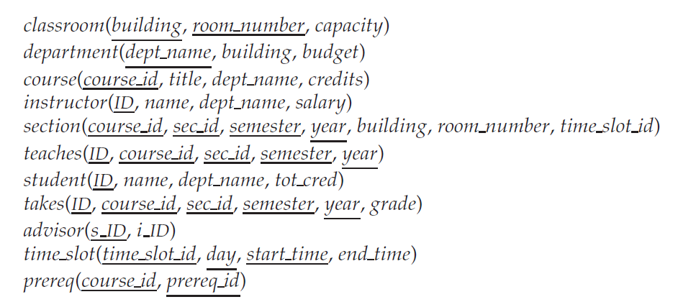
University Schema

Slide 29
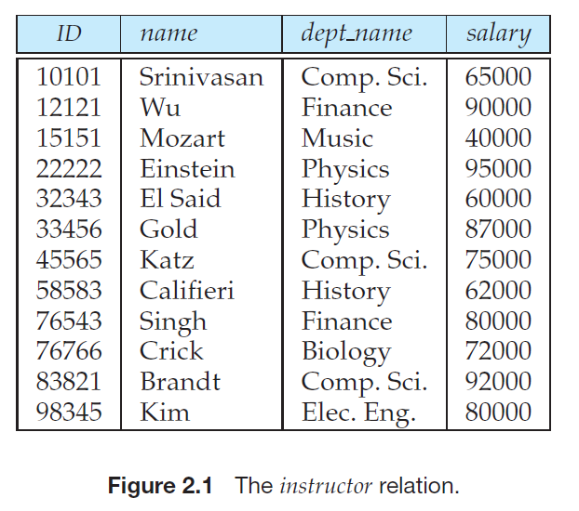
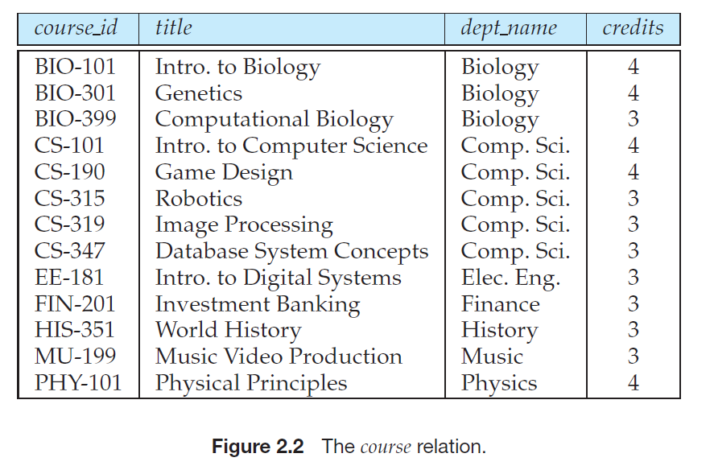
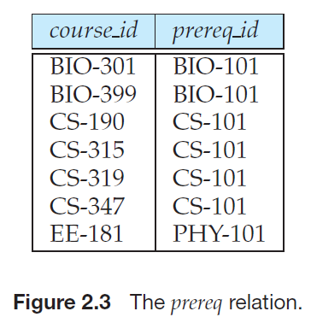
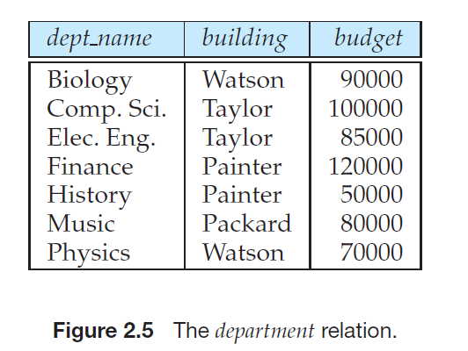

Slide 30
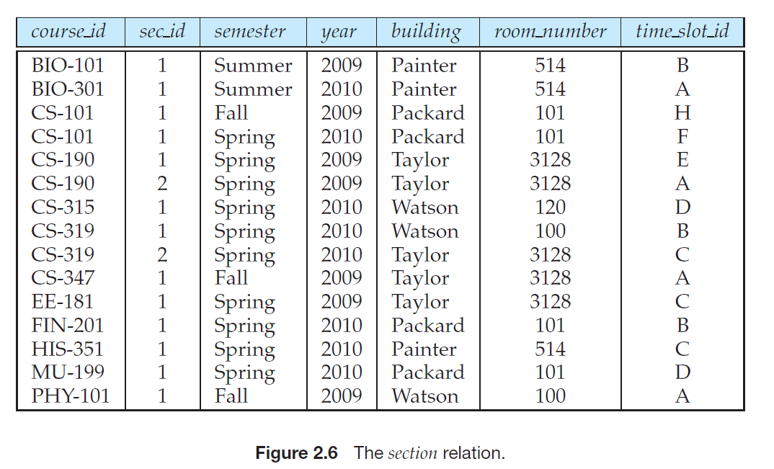
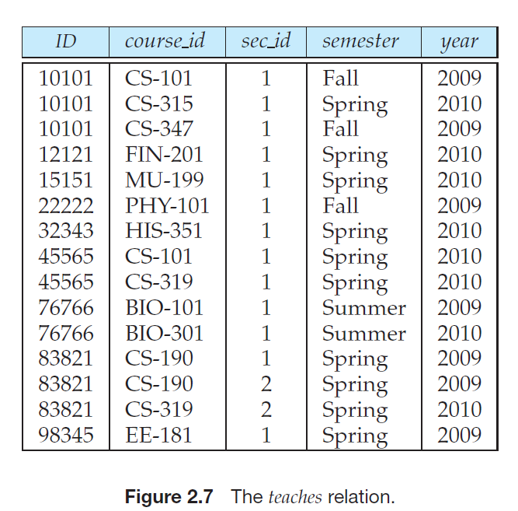

Slide 31
Suggested Reading
Chapter 5 of Database Systems: A Practical Approach to Design, Implementation, and Management by Thomas Conolly 6th Edition
Chapter 6 of Database System Concepts by Abraham Silberschatz

